Slide 1
Parallel Progress: A Comparative Study Of Urbanisation in the UAE and Singapore
Ahamed Foisal & Maitha AlGhfeli

Slide 2

INTRODUCTION ON THE UNITED ARAB EMIRATES
The United Arab Emirates was officially established on December 2, 1971. Known for its modern skyline, luxury lifestyle, and diverse economy fueled by oil and tourism, the UAE comprises seven emirates, with Dubai and Abu Dhabi being prominent global business and tourist hubs.

Slide 3
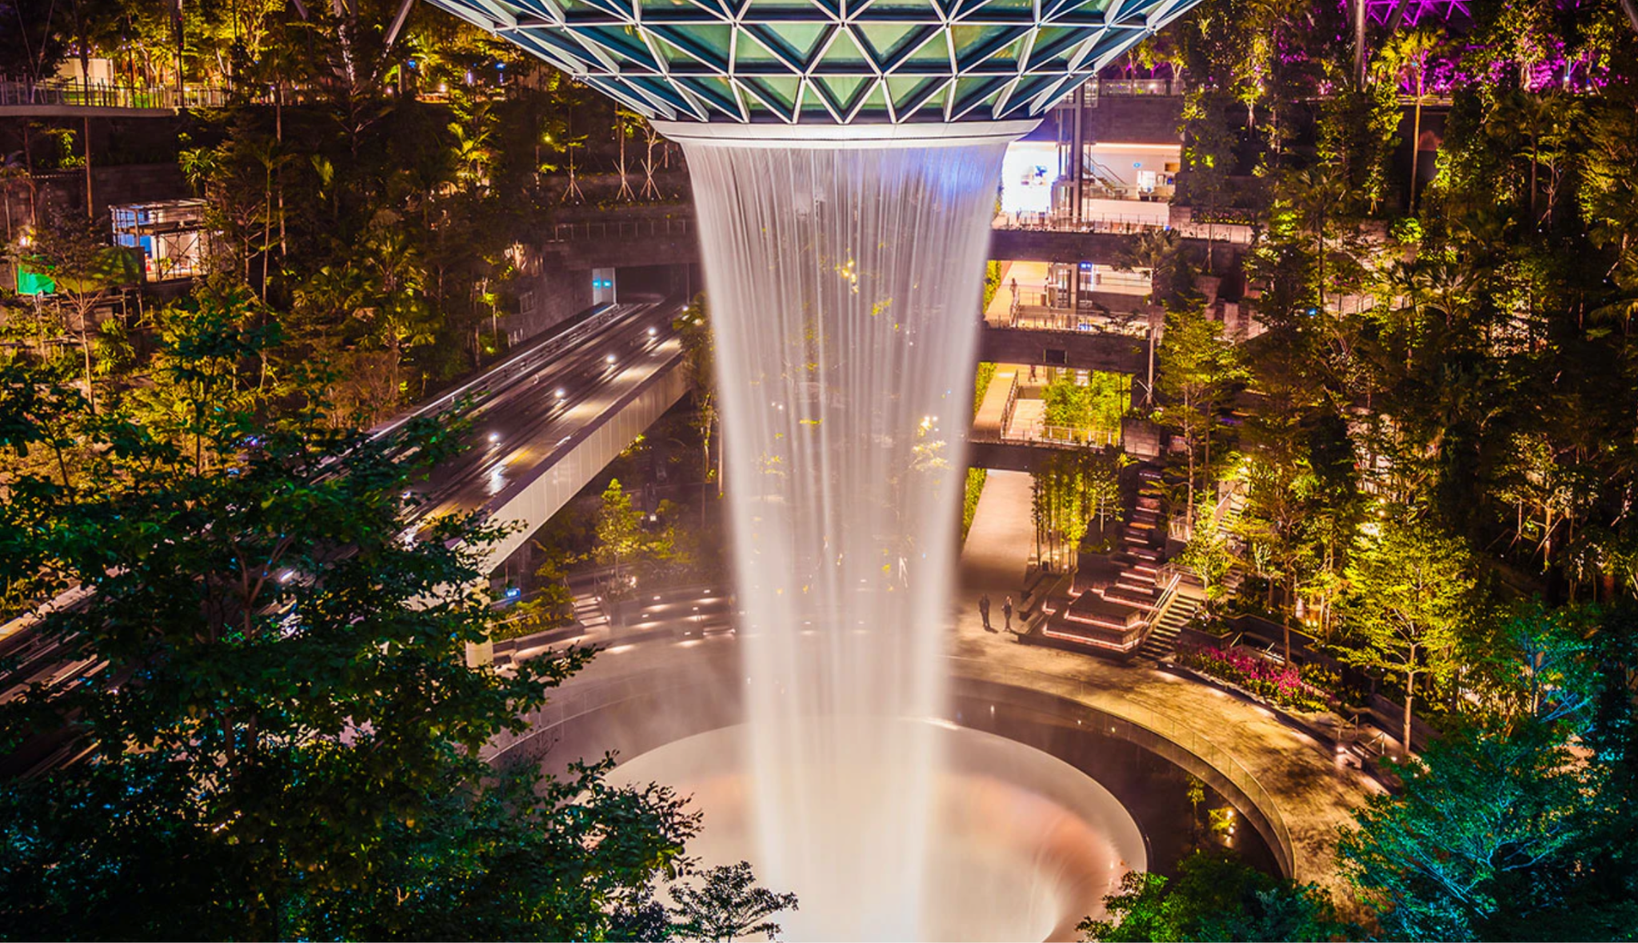
INTRODUCTION ON SINGAPORE
Singapore gained independence on August 9, 1965. Renowned for its efficient governance, economic prosperity, and multicultural society, Singapore is a global financial center. The city-state is celebrated for its cleanliness, advanced infrastructure, and strategic location as a key trading hub in Southeast Asia.

Slide 4
AIM & OBJECTIVE
FOCUS
Urban expansion, forestry changes, ecological reserves, and environmental impact.
FOCUS
COMPARATIVE ANALYSIS
ANALYSIS
Examine and compare the urbanization, ecological changes, and industrial growth in the UAE and Singapore since their independence.
OBJECTIVE
OBJECTIVE
Analyzing urbanization patterns in the UAE and Singapore to understand their global environmental impacts.

Slide 5
GLOBAL OBJECTIVES & GOALS
OBJECTIVE
GOAL
To elucidate urbanisation patterns and their global environmental impacts.
To develop sustainable urbanisation guidelines contributing to the UN’s New Urban Agenda, and providing a model for countries undergoing similar transformations.

Slide 6
DATA SOURCES & GLOBAL COLLABORATION
SOURCES
Satellite imagery from Google Earth, climate data from EOSDIS (Earth Observing System Data and Information System), UNEP, and UN data repositories.
DATA PROCESSING
Collaborating with UN experts for data collection, digitization, and ethical management.
ETHICAL ASPECTS
Aligning with UN standards for responsible and ethical data use.

Slide 7
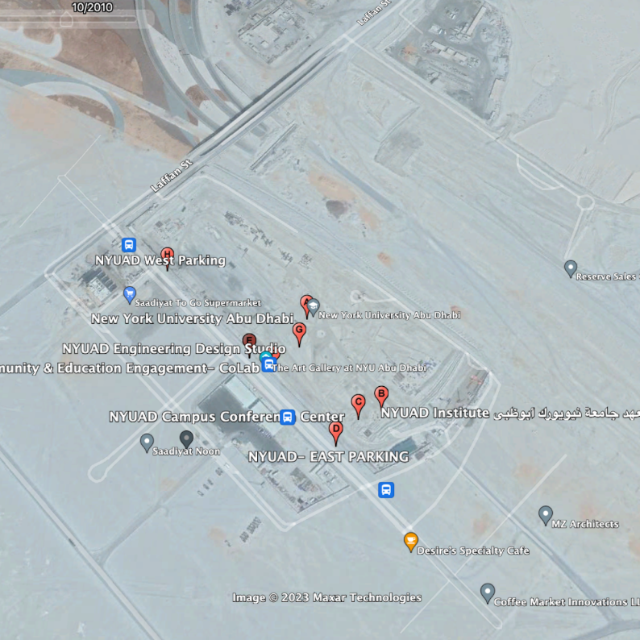
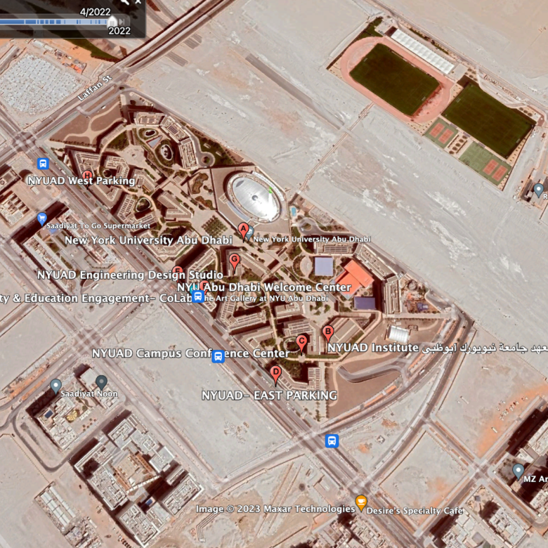
SAMPLE SATELLITE DATA

Slide 8
TECHNIQUES APPLIED
METHODS
GIS analysis and climate data comparison, in line with UN-Habitat guidelines.
ENVIRONMENTAL IMPACT ANALYSIS
TECHNIQUES
Utilizing machine learning to identify patterns and quantify the impact of urbanization decisions on the environment, such as changes in green spaces, air quality, and water resources.
Incorporating UN-endorsed data mining and time-series analysis methods.
INTEGRATION
Using digital humanities methods to achieve UN Sustainable Development Goals.
Notes:
GIS - Geographic information system

Slide 9
WORKING WITH DATA
GEORECTIFICATION
GIS DAY 2016
Georectification aligns satellite imagery with coordinates, improving map accuracy for tracking urbanization and environmental changes in the UAE and Singapore across different types of maps (analog, digital, heat-maps, etc.)
GIS Day 2016 featured events where organizations and communities showcased the applications of Geographic Information Systems technology through workshops, seminars, and exhibitions. We will leverage such events to include more GIS methods in our work and to have platform for presentation and collaboration.
geoAI
GeoAI automates analysis, aiding precise urban planning and environmental monitoring, providing real-time insights and future predictions for sustainable development in both regions.
Notes:
GIS - Geographic information system

Slide 10
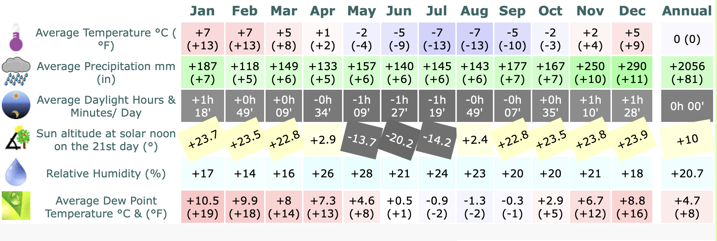
SAMPLE DATA TO ANALYSE
The table shows values for Singapore relative to Dubai. You can also view this comparison the other way around from the perspective of Dubai vs Singapore.
SOURCE
Singapore vs Dubai Climate & Distance Between

Slide 11
WORKPLAN
PHASES
DISSEMINATION
JUPITER
SATURN
From initial data collection to analysis, under the guidance of UN-Habitat.
Presenting findings at UN conferences, publishing in international journals, and online platforms.

Slide 12
THANKS!
Do you have any questions?

